Slide 1

BANGALORE INSTITUTE OF TECHNOLOGY
K.R.ROAD, V.V.PURAM, BANGALORE - 560004
DEPARTMENT OF INFORMATION SCIENCE AND ENGINEERING
Project Work (21ISP76) on
“CARDIOVASCULAR DISEASE PREDICTION USING ENSEMBLE TECHNIQUE”
Under the guidance of :
Presented By
Dr. Hema Jagadish
Associate Professor
Department of ISE
B.I.T
Manas Chagi 1BI21IS051
Abhishek G 1BI21IS069
Theju T S 1BI21IS124
Bhargava K R 1BI21IS125
.

Slide 2
CONTENTS
Abstract
Introduction
Literature Survey
Problem Statement
Objectives
Methodology
Architecture Diagram
Detailed Design
Data Flow Diagram
Use case Diagram
Sequence Diagram
Implementation
Results With Snapshots
References

Slide 3
ABSTRACT
The project focuses on predicting cardiovascular disease using ensemble machine learning technique and ECG image processing. The system enhances ECG images by converting them to grayscale, reducing noise with Gaussian smoothing, and extracting waveforms. Principal Component Analysis (PCA) helps reduce dimensionality while preserving key features. A Voting Classifier combines SVM, kNN, Random Forest, Gaussian Naive Bayes, and Logistic Regression, using a soft voting strategy to improve accuracy. The project is Built with scikit- learn and Streamlit, the system provides an easy-to-use interface for medical professionals to upload ECG images and receive predictions, highlighting the potential of AI for non- invasive heart disease diagnosis.

Slide 4
INTRODUCTION
Cardiovascular disease is one of the leading causes of death globally, highlighting the need for early detection and accurate diagnosis to improve patient outcomes.
Traditional diagnostic methods, particularly those based on Electrocardiogram (ECG) signals, often require manual analysis, which can be time-consuming and prone to human error.
The project Cardiovascular Disease Prediction Using Ensemble seeks to automate this process by utilizing advanced image processing and machine learning techniques to predict cardiovascular diseases from ECG images. By employing an ensemble technique, the system combines the strengths of multiple models to enhance prediction accuracy and reliability. This report outlines the methodologies, data processing steps, and model implementation involved in creating a robust ECG-based prediction system for cardiovascular disease.

Slide 5
LITERATURE SURVEY
[1]: “Digitization of Printed ECG Data Using Image Processing Techniques”
Authors: Tahmida Tabassum and Mohiuddin Ahmad
Key Findings:
High Accuracy Digitization: The method ensures precise conversion of printed ECG data into digital form, improving storage, analysis, and clinical applications.
Efficient Data Handling: The digitized ECG reduces data size while maintaining waveform integrity, enabling real-time processing and diagnosis.
Drawbacks:
Sensitivity to Noise: The accuracy of digitization can be affected by noise and distortions in printed ECG records, requiring additional preprocessing.
Dependency on Image Quality: The method relies on high-resolution scans and may not perform well on low-quality or degraded ECG strips.

Slide 6
[2]: “Review of Ensemble Learning Techniques for Disease Prediction”
Title: “Review of Ensemble Learning Techniques for Disease Prediction”
Authors: Palak Mahajan et al.
Key Findings:
Stacking Achieves Highest Accuracy: Stacking outperformed other ensemble methods, particularly in predicting skin disease and diabetes.
Method-Specific Strengths: Bagging worked best for kidney disease, while boosting excelled in liver disease and diabetes predictions.
Drawbacks:
Performance Variability: The effectiveness of ensemble methods varied across different diseases and datasets, requiring case-specific model selection.
Complexity in Implementation: Stacking and other ensemble techniques require extensive computational resources and careful parameter tuning.

Slide 7
[3]: “An Empirical Comparison of Voting Classification Algorithms: Bagging, Boosting, and Variants”
Title: “An Empirical Comparison of Voting Classification Algorithms: Bagging, Boosting, and Variants”
Authors: Bauer and Kohavi
Key Findings:
Bagging Reduces Variance: Bagging proved effective in minimizing variance, enhancing model stability across different datasets.
Boosting Enhances Accuracy: Boosting significantly reduced bias, improving overall classification performance.
Drawbacks:
Risk of Overfitting: Boosting can be sensitive to noisy data, leading to overfitting in certain cases.
Computational Complexity: Both bagging and boosting require substantial computational resources, making them expensive for large datasets.

Slide 8
[4]: “Effectiveness of Ensemble in Observational Healthcare Data”
Title: “Effectiveness of Ensemble in Observational Healthcare Data”
Authors: Behzad Naderalvojoud and Tina Hernandez-Boussard
Key Findings:
Improved Prediction Accuracy: The ensemble model enhanced AUROC and AUPRC metrics, improving the classification of patients at risk of prolonged opioid use.
Comprehensive Risk Assessment: By combining models trained on different covariates, the approach provided deeper insights into risk factors influencing opioid dependency.
Drawbacks:
Complexity in Model Integration: Combining multiple models increases computational requirements and complexity in implementation.
Data Dependency Issues: The effectiveness of the ensemble approach relies heavily on the quality and completeness of healthcare datasets.

Slide 9
PROBLEM STATEMENT
The challenge is to develop an automated system for predicting cardiovascular diseases using ECG signals, reducing reliance on manual interpretation, which is time-consuming and error-prone. By leveraging image processing and machine learning, the system aims to enhance detection accuracy, scalability, and early diagnosis.

Slide 10
Objectives
ECG Image Preprocessing: To enhance the quality of ECG images, apply preprocessing techniques such as grayscale conversion, Gaussian smoothing, and thresholding to remove noise and improve the clarity of important features in the ECG signals.
Lead Division and Signal Extraction: Extract individual ECG leads (12 standard leads and 1 long lead) from the ECG images to isolate the distinct heart electrical signals.
Feature Extraction and Signal Transformation: Extract meaningful features from the ECG signals by identifying key signal characteristics. This will involve techniques such as contour extraction, dimensionality reduction using PCA and scaling for normalization.
Ensemble Learning Model Development: Develop a robust classification model using
ensemble techniques.

Slide 11
Model Evaluation and Performance Assessment: Evaluate the model using metrics such as accuracy, precision, recall, and F1-score to ensure that the system can correctly classify ECG signals into different categories, such as normal heart rhythm, abnormal heartbeats, or indications of myocardial infarction.
Prediction for Early Diagnosis: To provide an accurate and timely prediction of cardiovascular diseases, enabling early intervention, and supporting clinical decision making for healthcare professionals.

Slide 12
METHODOLOGY
1. ECG Image Collection and Preprocessing
- Collect ECG images in formats such as PNG, JPG, or JPEG.
- Convert images to grayscale to simplify analysis and reduce complexity.
2. Dividing ECG Leads
- Divide ECG images into 13 individual leads (12 standard leads and 1 long lead).
- Treat each lead as a separate region of interest (ROI) for analysis.
3. Signal Extraction and Feature Scaling
- Enhance ECG signals using contour detection to extract features.
- Normalize signal values with Min-Max Scaling for machine learning models.
4. Dimensionality Reduction with PCA
- Use Principal Component Analysis (PCA) to reduce dimensionality.
- Retain the most significant features while removing redundant information.

Slide 13
5. Ensemble Learning for Classification
- Employ Logistic Regression, KNN, Decision Trees, Random Forest, and Naive Bayes.
- Combine predictions of individual models for a robust final diagnosis.
6. Model Training and Evaluation
- Train models on labeled ECG data and apply cross-validation.
- Evaluate performance using metrics like accuracy, precision, recall, and F1-score.
- Select the best-performing model based on evaluation results.
7. Prediction and Results
- Use the trained model to predict cardiovascular diseases, such as myocardial infarction.
- Provide a diagnostic output to assist healthcare professionals in decision-making

Slide 14
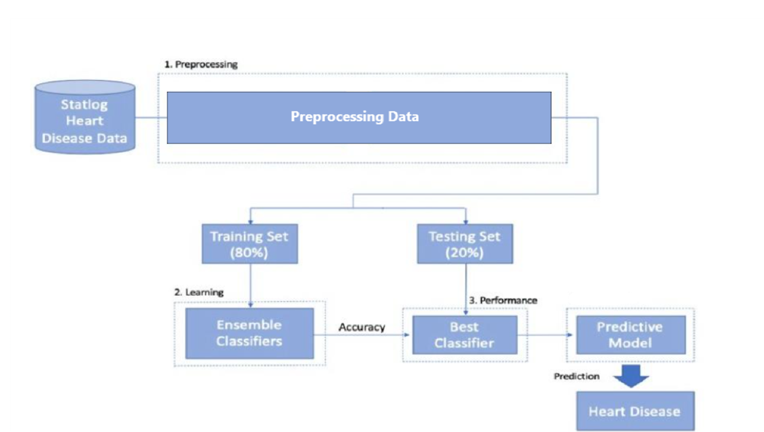
ARCHITECTURAL DESIGN

Slide 15
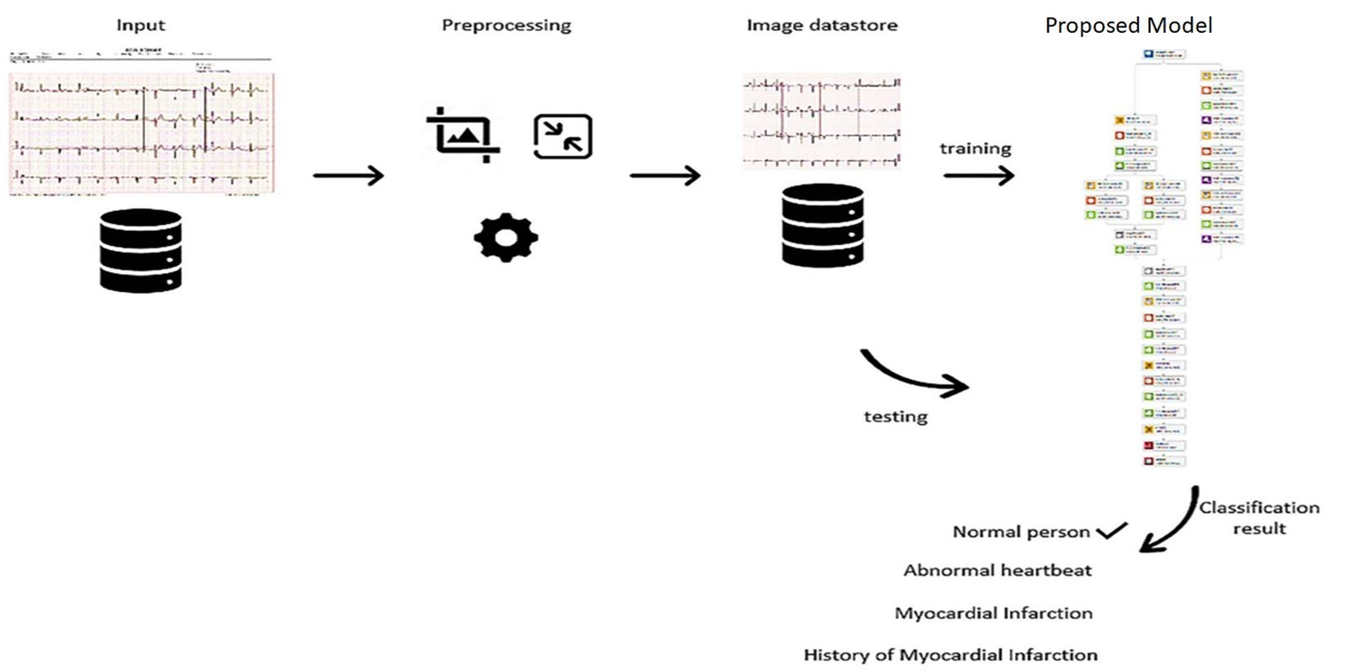
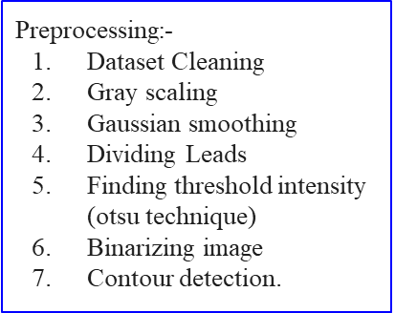
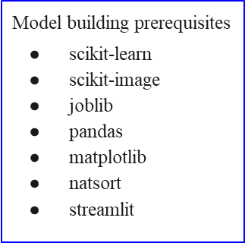
Detailed Design

Slide 16
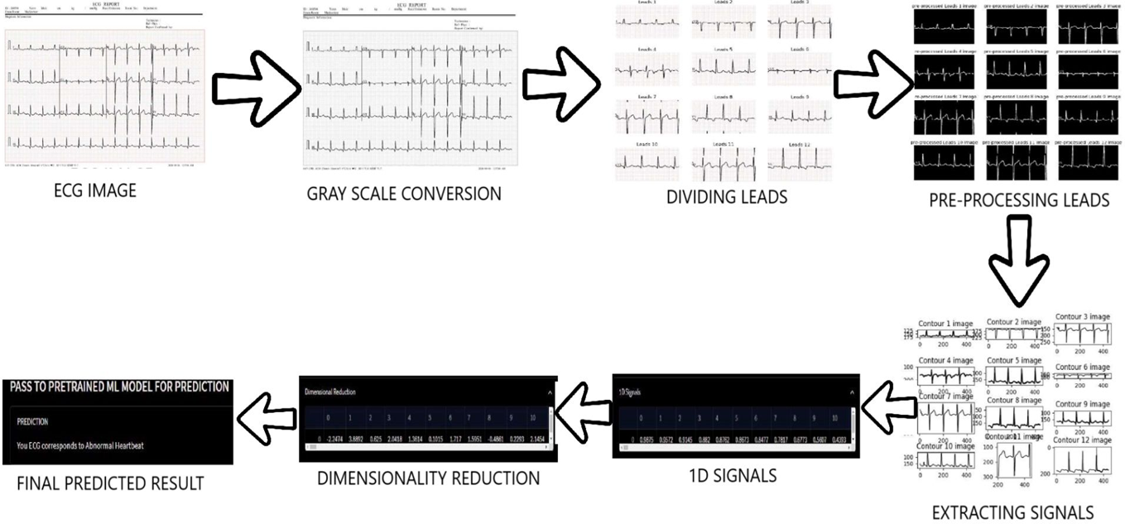
DATA FLOW DIAGRAMS

Slide 17
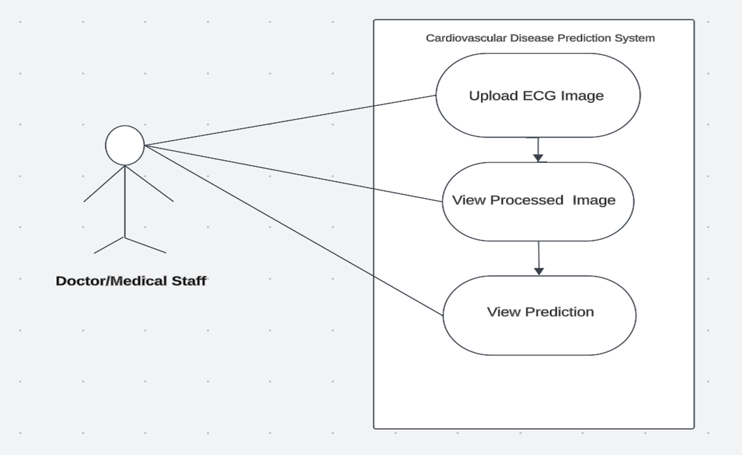
USE CASE DIAGRAM

Slide 18
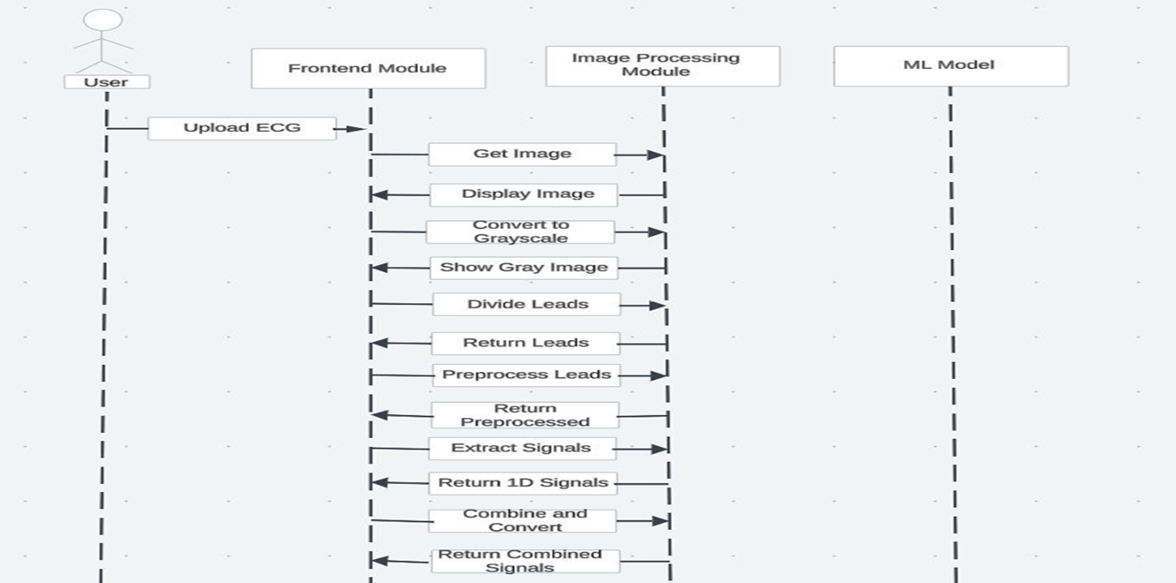
SEQUENCE DIAGRAM

Slide 19
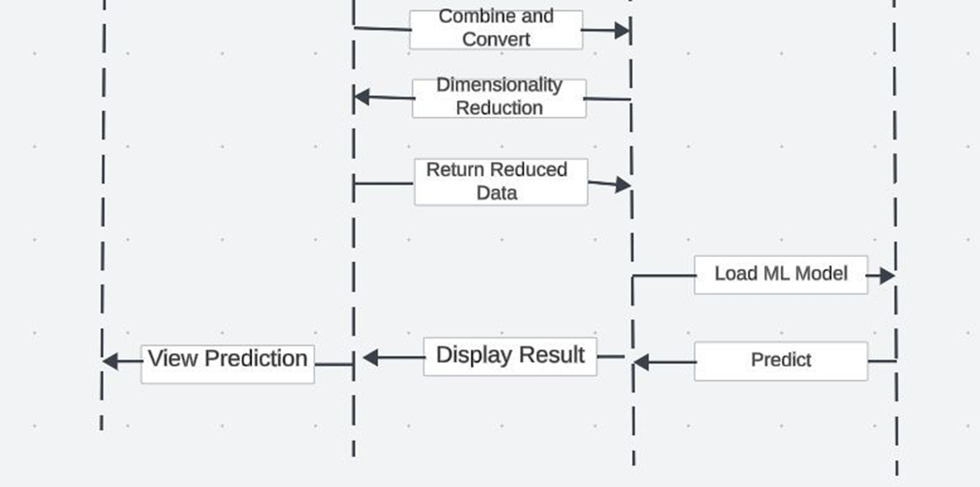

Slide 20
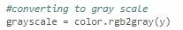
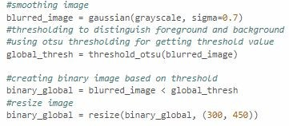
IMPLEMENTATION
Module 1: Image Processing
Grayscale Conversion: Transforming RGB ECG images into grayscale to simplify intensity-based analysis.
Gaussian Smoothing: Applying a Gaussian filter to reduce noise and enhance signal clarity.

Slide 21
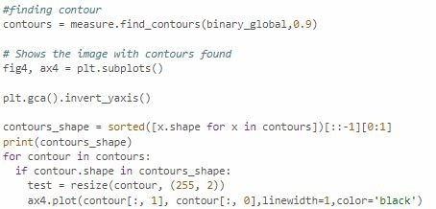
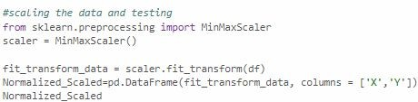
Contour Extraction: Identifying and extracting contours to outline and isolate ECG waveforms.
Data Scaling: Standardizing signal data to ensure consistency

Slide 22
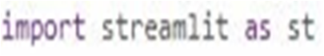
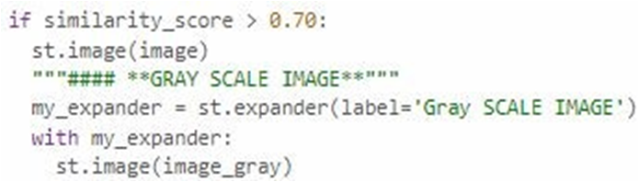
Module 2: Front-end(Streamlit)
● Importing the library
● Displaying images after GrayScaling

Slide 23
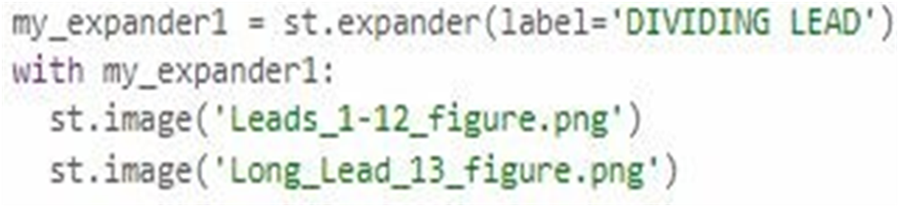
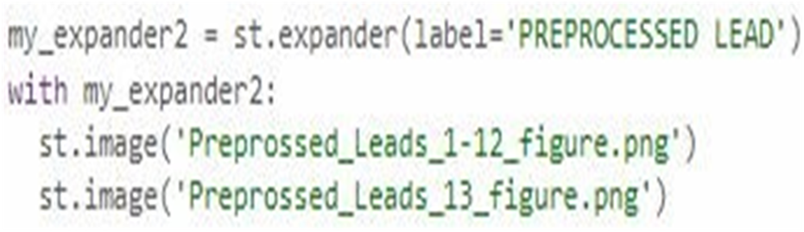
● Dividing leads and displaying
● Displaying Leads after Pre-Processing

Slide 24
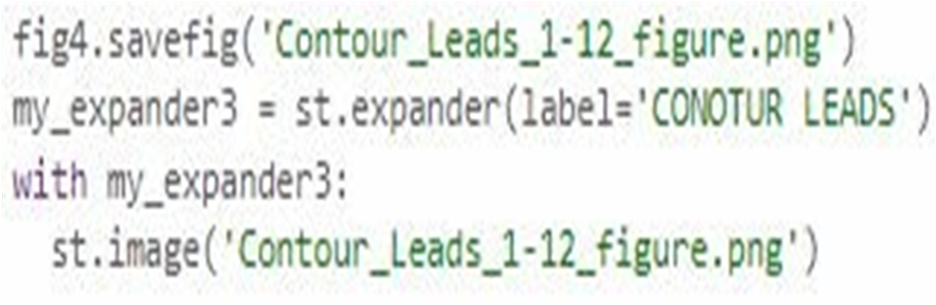
● Displaying Contours

Slide 25
Module 3: Prediction Model
Ensemble Modeling for Cardiovascular Disease Prediction:
Ensemble modeling is a technique that combines predictions from multiple base learners to form a robust prediction model, leveraging their collective wisdom to enhance accuracy and reduce variance
Ensemble
Hard Voting
Soft Voting
Each gives probability score, average taken
Majority classification

Slide 26
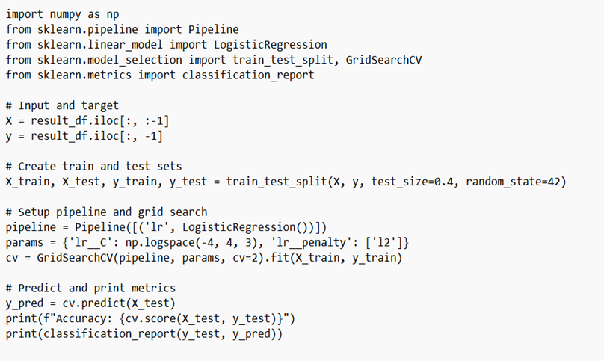
Logistic Regression
Logistic regression is a statistical method used for classification that predicts the probability of a binary outcome based on one or more predictor variables by using a logistic function.

Slide 27
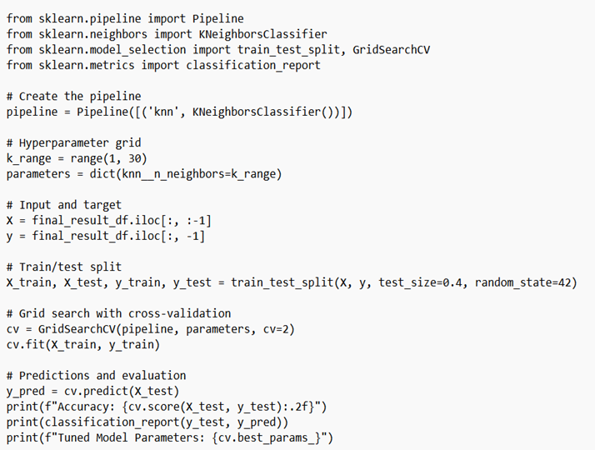
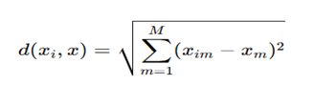
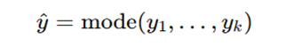
k-Nearest Neighbors algorithm
K-Nearest Neighbors (KNN) is a machine learning algorithm that classifies data points based on the majority class of their k closest neighbors in the feature space.
Algorithm:
1. Choose k: Select the number of neighbors
2. Calculate Distance:
3.Find Neighbors: Identify the k closest points.
4. Prediction:

Slide 28
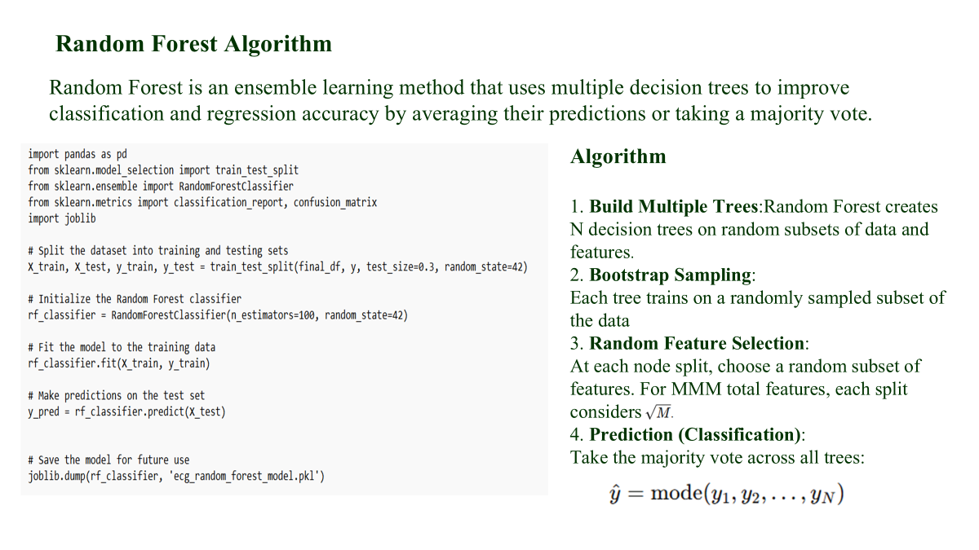

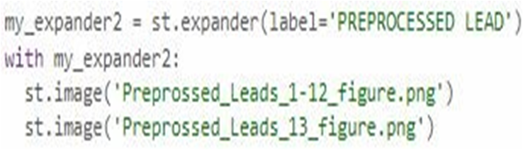
● Dividing leads and displaying
● Displaying Leads after Pre-Processing

Slide 29
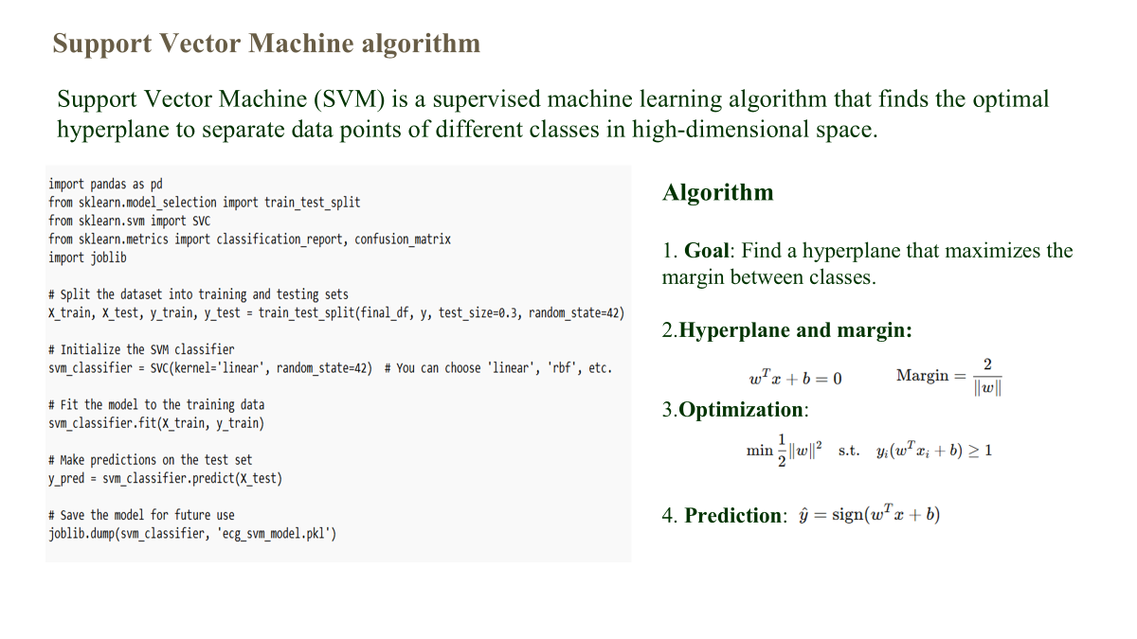

● Displaying Contours

Slide 30
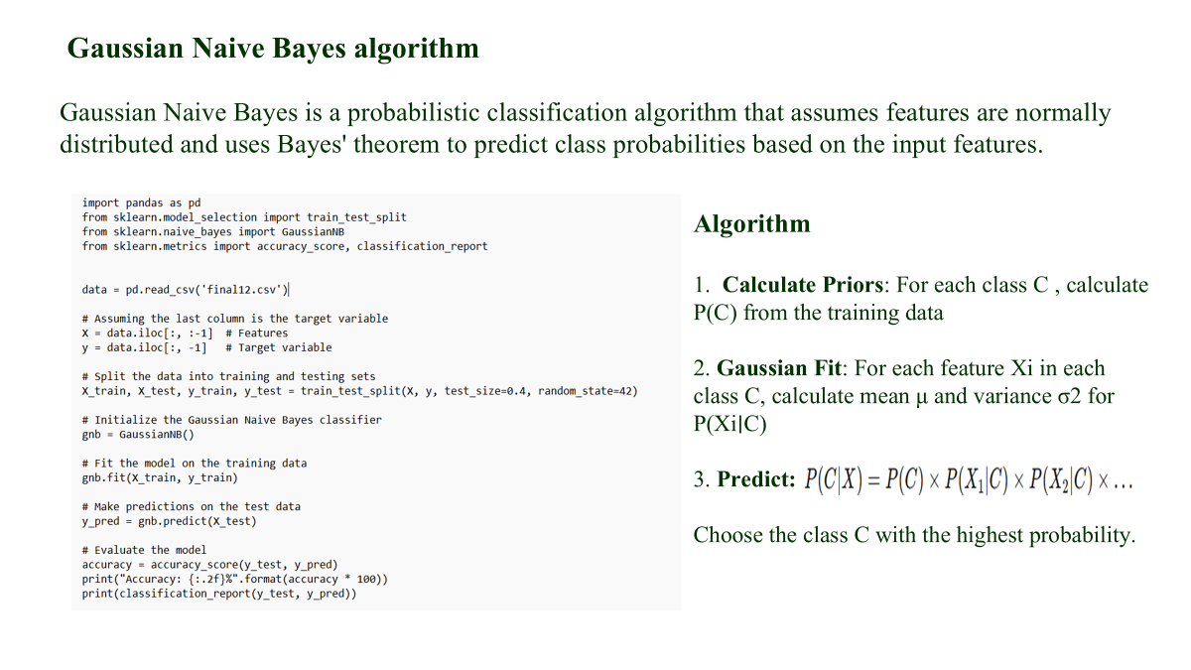

Slide 31
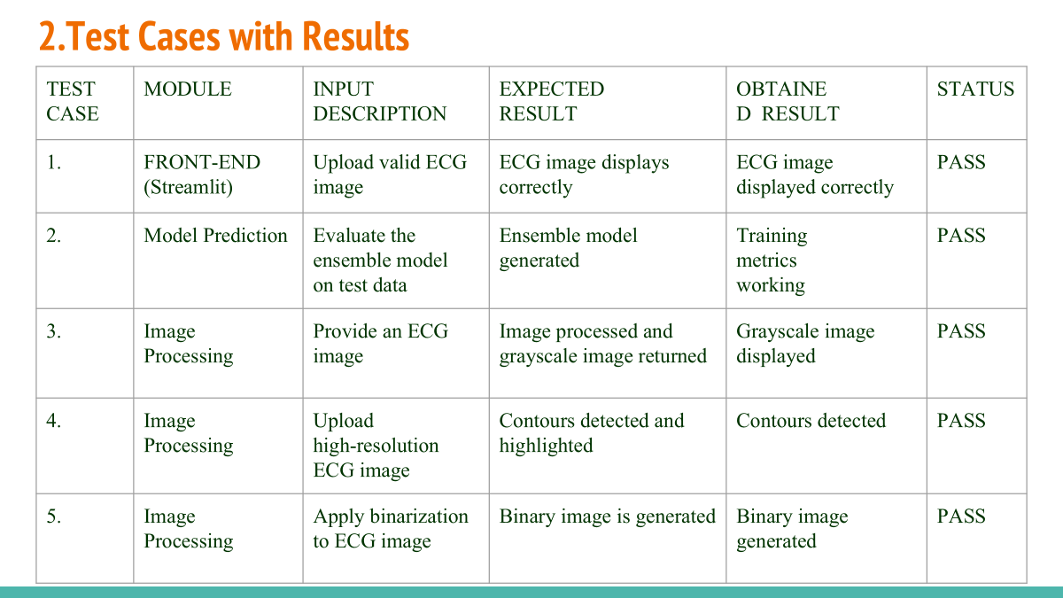
Testing : Frontend and Image Processing Module

Slide 32
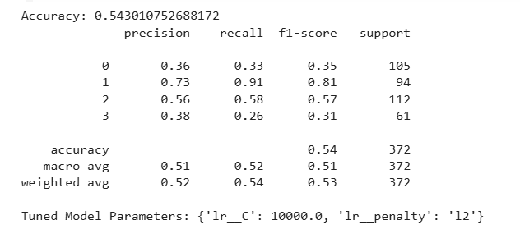
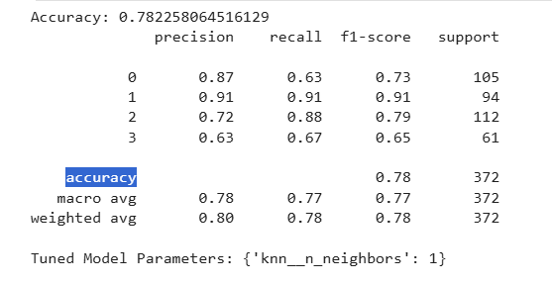
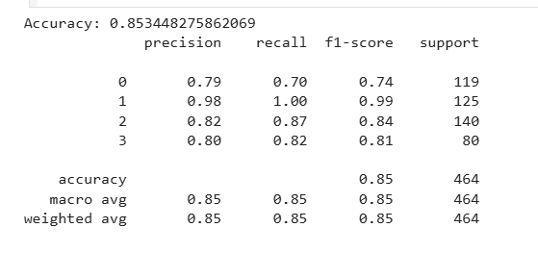
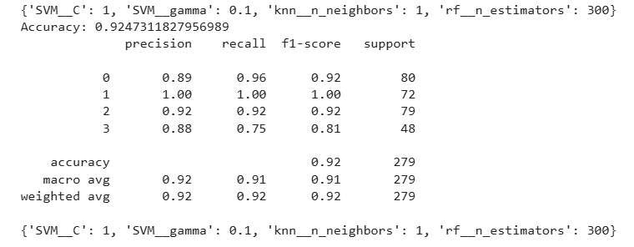
Testing : Model Performance Metrics

Slide 33

Results with Snapshots

Slide 34
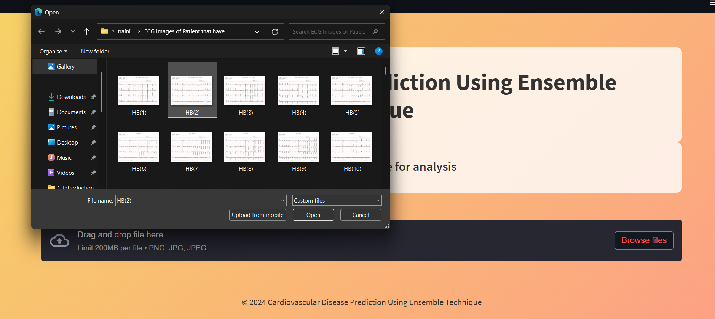

Slide 35


Slide 36
References
[1] Tabassum, Tahmida, and Mohiuddin Ahmad. "Numerical data extraction from ECG paper recording using image processing technique." 2020 11th international conference on electrical and computer engineering (ICECE). IEEE, 2020.
[2] McAuliffe, Matthew J., et al. "Medical image processing, analysis and visualization in clinical research." Proceedings 14th IEEE symposium on computer-based medical systems. CBMS 2001. IEEE, 2001.
[3] Mahajan, Palak, et al. "Ensemble learning for disease prediction: A review." Healthcare. Vol. 11. No. 12. MDPI, 2023.
[4] Bauer, Eric, and Ron Kohavi. "An Empirical Comparison of Voting Classification Algorithms: Bagging, Boosting, and Their Variants." Machine Learning, vol. 36, no. 1-2, 1999, pp. 105–139. Springer, doi:10.1023/A:1007515423169
[5] Naderalvojoud, Behzad, and Tina Hernandez-Boussard. "Improving machine learning with ensemble learning on observational healthcare data." AMIA Annual Symposium Proceedings. Vol. 2023. 2024.

Slide 37


